Slide 1
Status update

Slide 2
Things I have done
Added all the NLP pipeline I will ever need (STANZA)
Implemeted the robotics toolbox module
Created movement demonstration before deployment on UR
Created invers kinematic system on robotics toolbox instead of invers kinematics on UR
Cool actions design

Slide 3
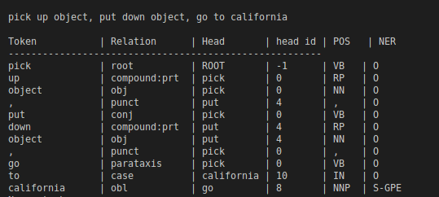
NLP pipeline STANZA

Slide 4

NLP pipeline STANZA

Slide 5
Created movement demonstration before deployment on UR

Slide 6
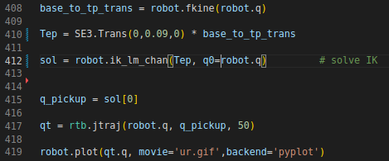
Inverskinematics in robotics system toolbox

Slide 7
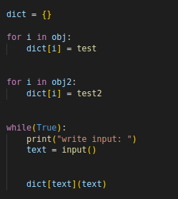
Cool actions design

